Slide 1
Ch.13 Structure

Slide 2

What you will learn in this chapter
Structures are an important tool for grouping different data together .
Structure concept, definition, and initialization method
Relationship between structures and pointers
Unions and typedefs

Slide 3
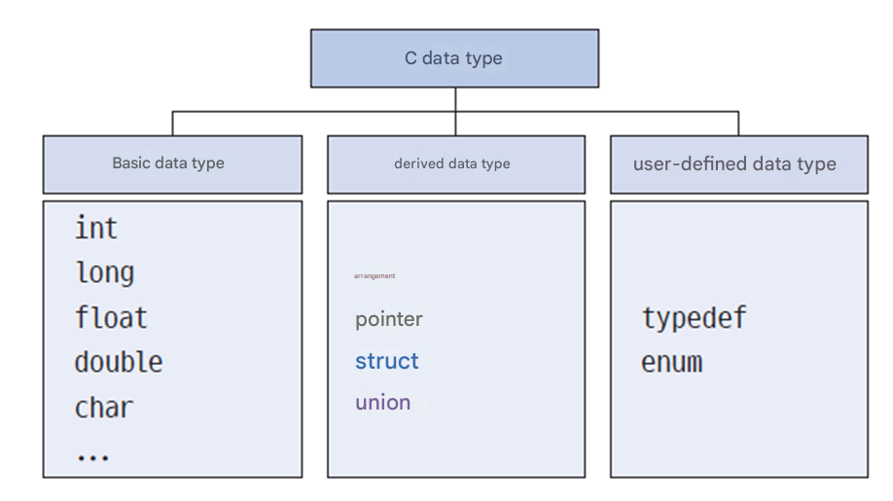
Classification of data types
Array

Slide 4
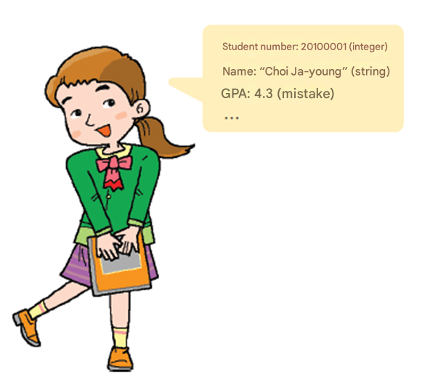
The need for structures
How to gather data about students into one place ?
int number;
char name[10]; double grade;
It can be expressed as individual variables like this, but can it be grouped ?
Student number: 20251234 (Number)
Name: “first last” (String)
Grade: 4.3 (Real number)
…

Slide 5
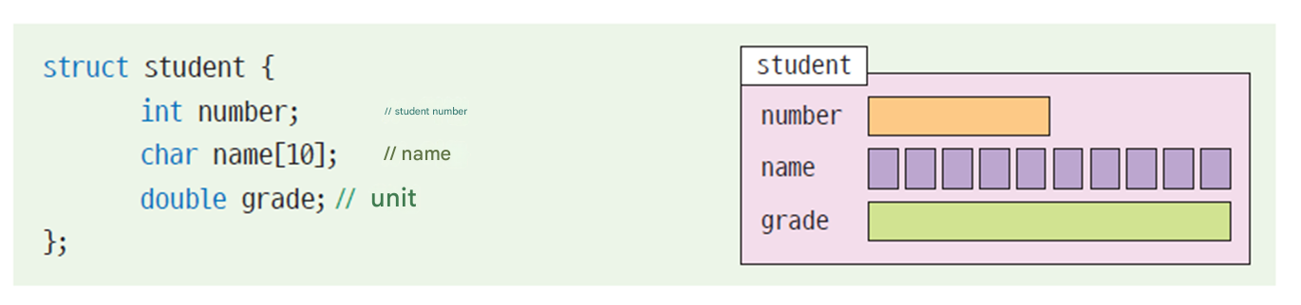
The need for structures
Structures allow you to group
variables together.

Slide 6
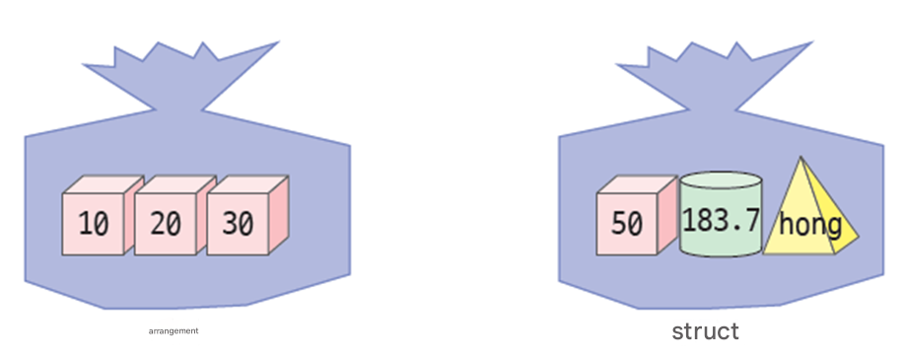
Arrays and Structures
Array
Group variables of the same type
Group variables of different types

Slide 7

Check points
1. Discuss the difference between structures and arrays .
2. Struct example

Slide 8
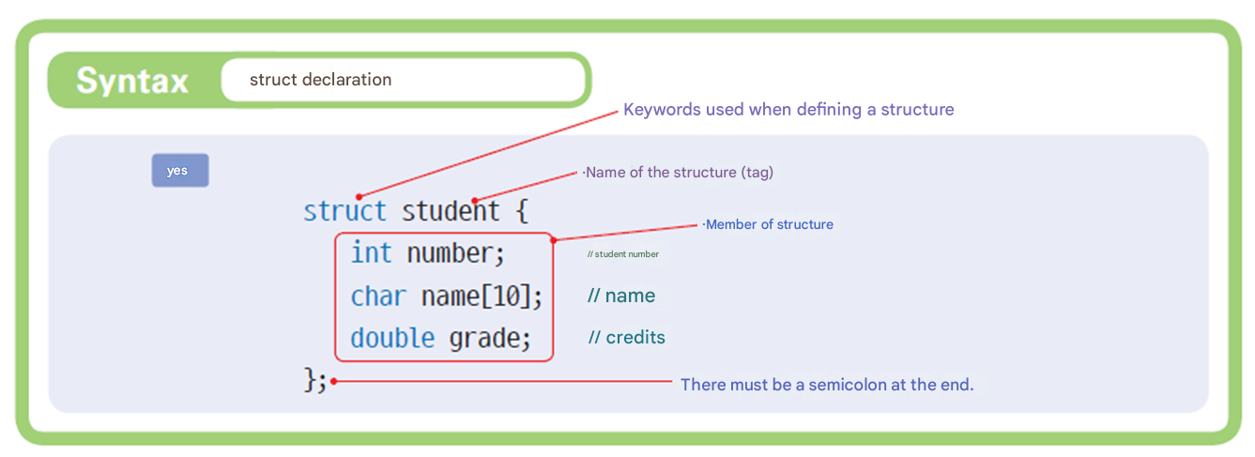
Structure declaration

Slide 9
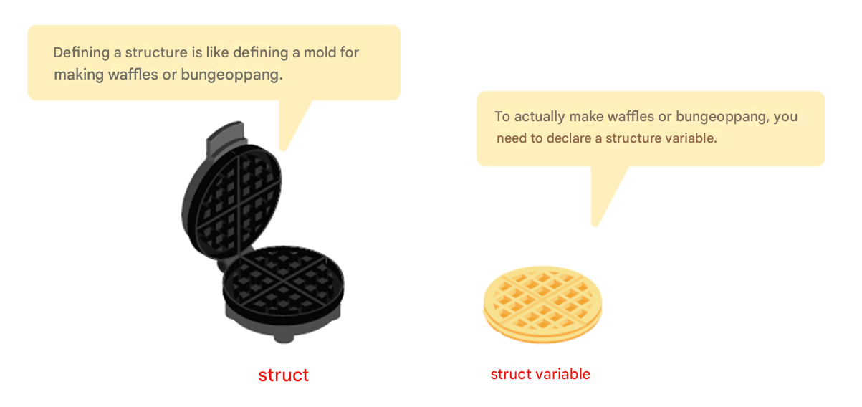
Structure declaration
A structure declaration is not a variable declaration.

Slide 10
Example of a structure declaration
// Screen coordinates made up of x
struct point {
int x; // x coordinate
int y; // y coordinate
};
// date
struct date {
int month;
int day;
int year;
};
// Complex number
struct complex {
double real; // real part
double imag ; // imaginary part
};
// square
struct rect angle {
int x , y ;
int width;
int height ;
};

Slide 11
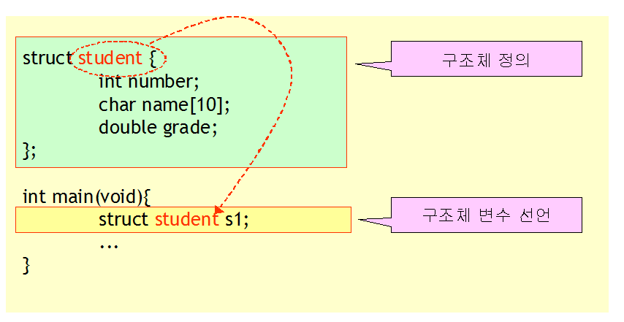
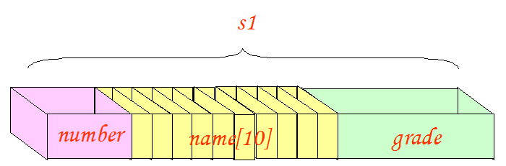
Declaring a structure variable
Defining a structure and declaring a structure variable are different.

Slide 12
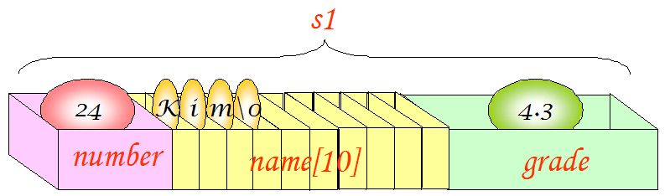
Initializing a structure
Initial values are listed using curly brackets .
struct student {
int number;
char name[10];
double grade;
};
struct student s1 = { 24, "Kim" , 4.3 };

Slide 13
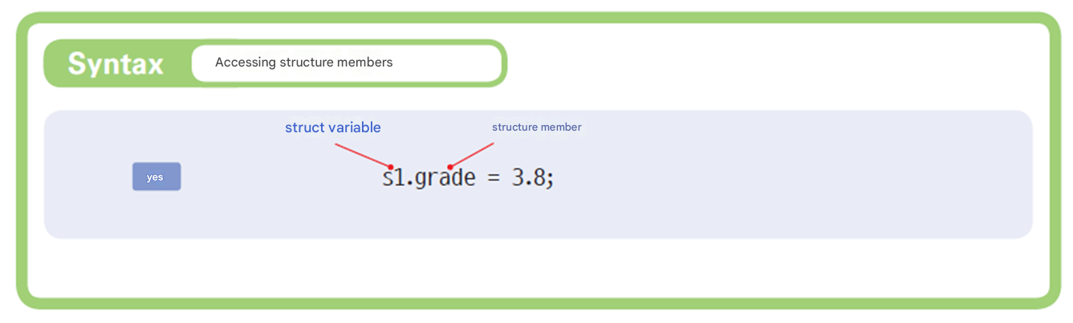
Structure member reference
. symbol is an operator used when referencing members in a structure .
.

Slide 14

Example #1
…
struct student {
int number;
char name[10];
double grade ;
};
int main( void )
{
struct student s;
s.number = 20 23 0001;
strcpy (s.name, " Hong Gil-dong " );
s.grade = 4.3 ;​
printf ( "Student number : %d\n" , s.number );
printf ( "Name : %s\n" , s.name);
printf ( “Grade : % .2f \n" , s.grade ) ;
return 0;
}
Structure declaration
Declaring a structure variable
Structure member reference
Student number : 20230001
Name : Hong Gil-dong
GPA : 4.30

Slide 15
Example #2
struct student {
int number;
char name[10];
double grade;
};
int main( void )
{
struct student s;
printf ( " Student number Enter : " );
scanf ( "%d" , & s.number );
printf ( " name Enter : " );
scanf ( "%s" , s.name);
printf ( " Credit Enter ( error ): " );
scanf ( "%lf" , & s.grade );
printf ( “ \ nStudent number : %d\n" , s.number );
printf ( " Name : %s\n" , s.name);
printf ( " Grade : % .2f \n" , s.grade );
return 0;
}
Structure declaration
Declaring a structure variable
Passing the address of a structure member
Enter your student number : 20230001
Enter your name : Hong Gil-dong
Enter your grade ( error ): 4.3
Student number : 20230001
Name : Hong Gil-dong
GPA : 4.30

Slide 16
New initialization method
#include < stdio.h >
// Represents a point in two-dimensional space as a structure .
struct point {
int x;
int y;
};
int main( void )
{
struct point p = { 1, 2 }; // ①
struct point q = { .y = 2, .x = 1 }; // ②
struct point r = p; // ③
r = ( struct point ) { 1, 2 }; // ④ C99 version
printf( "p=(%d, %d)\n" , px, py);
printf( "q=(%d, %d) \n" , qx, qy);
printf( "r=(%d, %d)\n" , rx, ry);
return 0;
}

Slide 17
Lab: Representing points in two-dimensional space as structures
Get the coordinates of two points from the user and calculate the distance between the two points. The coordinates of the points are expressed as a structure .
Enter the coordinates of the point (xy): 10 10
Enter the coordinates of the point (xy): 20 20
The distance is 14.142136 .

Slide 18
Source code
#include < stdio.h >
#include < math.h >
struct point {
int x;
int y;
};
int main( void )
{
struct point p1, p2;
int xdiff , ydiff ;
double dist ;
printf ( " dot Coordinates Enter (x y): " );
scanf ( "%d %d" , &p1.x, &p1.y);
printf ( " dot Coordinates Enter (x y): " );
scanf ( "%d %d" , &p2.x, &p2.y);
p2 (x,y)
p1 (x,y)

Slide 19
Source code
xdiff = p1.x - p2.x;
ydiff = p1.y - p2.y;
dist = sqrt( (double)( xdiff * xdiff + ydiff * ydiff ) );
printf ( " The distance is % f .\n" , dist );
return 0;
}
Enter the coordinates of the point (x y): 10 10
Enter the coordinates of the point (x y): 20 20
The distance is 14.142136 .

Slide 20
Check points
1. Each variable declared within a structure is called ______ .
2. The keyword used to declare a structure is _______ .
3. Why are tags needed for structures , and what is the difference between using tags and not using them ?
4. Are variables created just by declaring a structure ?
5. What is the operator for referencing members of a structure ?

Slide 21
A structure that has structures as members.
struct date {
int year;
int month;
int day;
};
struct student { // Structure declaration
int number;
char name[10];
struct date dob ; // structure within structure
double grade;
};
s truct student s1; // Declare structure variable
s1.dob.year = 1983; // Member reference
s1.dob.month = 03;
s1.dob.day = 29;

Slide 22
Lab: Representing a rectangle as a point structure
the point structure from the previous example to represent the coordinates of the vertices .
Enter the coordinates in the upper left corner : 10 10
Enter the coordinates in the upper right corner : 20 20
The area is 100 and the perimeter is 40 .

Slide 23
Example
#include < stdio.h >
struct point {
int x;
int y;
};
struct rect {
struct point p1;
struct point p2;
};
int main( void )
{
struct rect r;
int w, h, area, peri;

Slide 24
Example
printf( "Enter the coordinates of the upper left corner: " );
scanf( "%d %d" , &r.p1.x, &r.p1.y);
printf( "Enter the coordinates of the upper right corner: " );
scanf( "%d %d" , &r.p2.x, &r.p2.y);
w = r.p2.x - r.p1.x;
h = r.p2.x - r.p1.x;
area = w * h;
peri = 2 * w + 2 * h;
printf( "Area is %d and perimeter is %d.\n" , area, peri);
return 0;
}
Enter the coordinates in the upper left corner : 1 1
Enter the coordinates in the upper right corner : 6 6
The area is 25 and the perimeter is 20 .

Slide 25
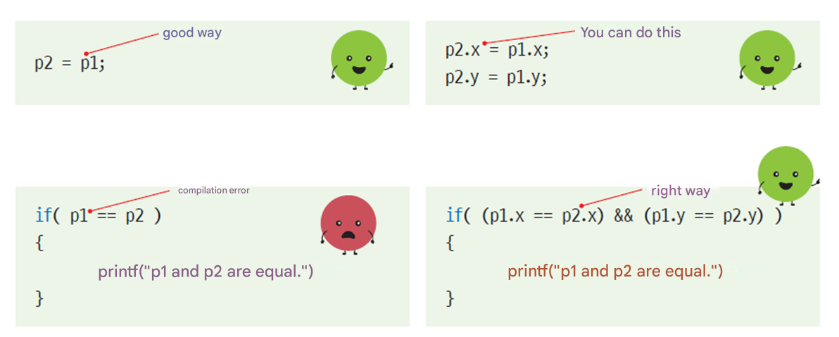
Assignment and comparison of structure variables
Assignment of variables of the same structure is possible, but comparison is not possible .

Slide 26
Example
Assignment of variables of the same structure is possible, but comparison is not possible .
struct point {
int x;
int y;
};
int main( void )
{
struct point p1 = {10, 20};
struct point p2 = {30, 40};
p2 = p1; // Substitution possible
if ( p1 == p2 ) // Compare -> Compile error !!
printf ( " p1 and p2 It's the same ." )
if ( (p1.x == p2.x) && (p1.y == p2.y) ) // Correct comparison
printf ( " p1 and p2 It's the same ." )
}

Slide 27
Check points
1. What operations are allowed between variables of a structure ?
2. What is the difference between structure tags and structure variables ?
3. Can a structure be inserted as a structure member ?
4. Can a structure have an array as a member ?

Slide 28
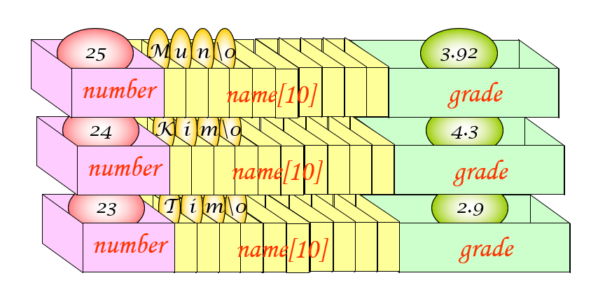
Array of structures
A collection of multiple structures

Slide 29
Array of structures
struct student {
int number;
char name[20];
double grade;
};
int main( void )
{
struct student list[100]; // Declare an array of structures
list[2].number = 24;
strcpy (list[2].name, " Hong Gil-dong " );
list[2].grade = 4.3;
}

Slide 30
Array of structures initialization
struct student list[3] = {
{ 1, "Park", 3.42 },
{ 2, "Kim", 4.31 },
{ 3, "Lee", 2.98 }
};

Slide 31
Calculate the number of elements in an array of structures
To automatically find the number of elements in an array of structure,Divide the total number of bytes in the entire array by the number of bytes in each element .
n = sizeof (list)/ sizeof (list[0]);
or
n = sizeof (list)/ sizeof (struct student);
This is only possible within the same function .

Slide 32
Example
#define SIZE 3
struct student {
int number;
char name[20];
double grade;
};
int main( void )
{
struct student list[SIZE];
int i;

Slide 33
Example
Enter your student number : 20190001
Enter your name : Hong Gil-dong
Enter your grade ( error ): 4.3
Enter your student number : 20190002
Enter your name : Kim Yu-shin
Enter your grade ( incorrect ): 3.92
Enter your student number : 20190003
Enter your name : Lee Seong-gye
Enter your grade ( incorrect ): 2.87
Name : Hong Gil-dong , Grade : 4.300000
Name : Kim Yu-shin , Grade : 3.920000
Name : Lee Seong-gye , Credit : 2.870000
for ( i = 0; i < SIZE; i ++)
{
printf ( " Student number Enter : " );
scanf ( "%d" , &list[ i ].number);
printf ( " name Enter : " );
scanf ( "%s" , list[ i ].name);
printf ( " Credit Enter ( error ): " );
scanf ( "%lf" , &list[ i ].grade);
}
for ( i = 0; i < SIZE; i ++)
printf ( " Student number : %d, Name : %s, Grade : %f\n" , list[ i ].number, list[ i ].name, list[ i ].grade);
return 0;
}

Slide 34
Check points
1. Define an array of structures that can store information about five products. Products have number, name , and price as members .

Slide 35
Structures and Pointers
Pointer to a structure
A structure that has pointers as members.
Number
sp
name
grade

Slide 36
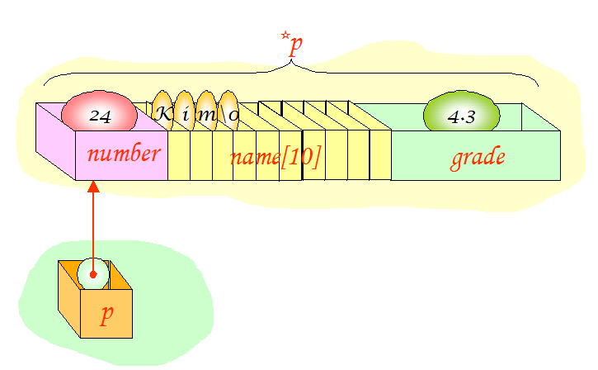
Pointer to a structure
struct student *p;
struct student s = { 24, “Kim”, 4.3 };
struct student *p;
p = &s;
printf("Student number =%d Name =%s Grade =%f \n" , s.number , s.name, s.grade );
printf("Student number =%d Name =%s Grade =%f \n" , (*p).number,(*p).name,(*p).grade);

Slide 37
-> Operator
-> operator is used when referencing a structure member with a structure pointer.
struct student *p;
struct student s = { 24, “Kim”, 4.3 };
struct student *p;
p = &s;
printf("Student number =%d Name =%s Key =%f \n", p-> number, p-> name, p-> grade);

Slide 38
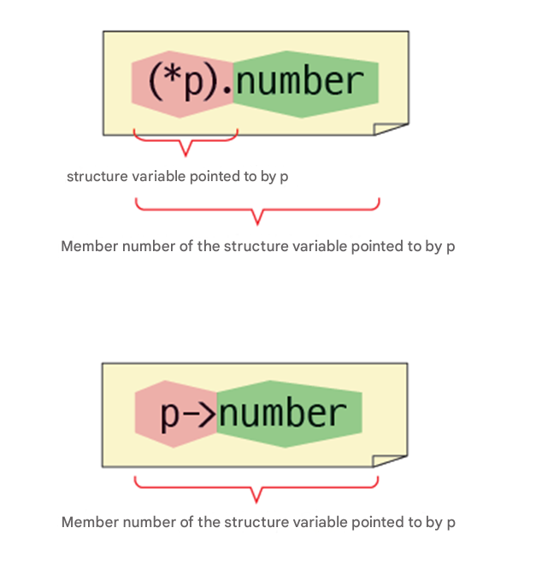
-> Operator

Slide 39
Example
// Referencing a structure through a pointer
#include < stdio.h >
struct student {
int number;
char name[20];
double grade;
};
int main( void )
{
struct student s = { 1, " Hong Gil-dong " , 4.3 };
struct student * p;
p = &s;
printf("Student number =%d Name =%s Grade =%f \n" , s.number , s.name, s.grade );
printf("Student number =%d Name =%s Grade =%f \n" , (*p).number, (*p).name, (*p).grade);
printf("Student number =%d Name =%s Grade =%f \n" , p->number, p->name, p->grade);
return 0;
}
Student number = 1 Name = Hong Gil-dong Grade = 4.300000
Student number = 1 Name = Hong Gil-dong Grade = 4.300000
Student number = 1 Name = Hong Gil-dong Grade = 4.300000

Slide 40
A structure that has pointers as members.
struct date {
int month;
int day;
int year;
};
struct student {
int number;
char name[20];
double grade;
struct date *dob ;
};

Slide 41
A structure that has pointers as members.
int main( void )
{
struct date d = { 3, 20, 2000 };
struct student s = { 1, "Kim" , 4.3 };
s.dob = &d;
printf("Student number : %d\n" , s.number );
printf("Name : %s\n" , s.name);
printf("Grade : %f\n" , s.grade );
printf(“Birth: Year %d month %d day \n" , s.dob ->year, s.dob ->month, s.dob ->day);
return 0;
}
Student number : 1
Name : Kim
Credit : 4.300000
Birth : March 20 , 2000

Slide 42
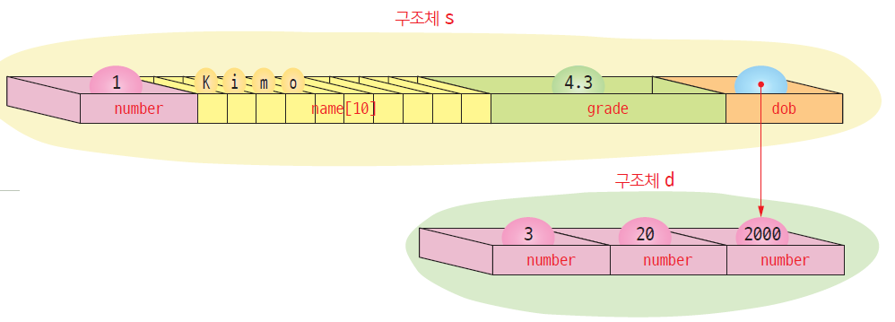
A structure that has pointers as members.

Slide 43
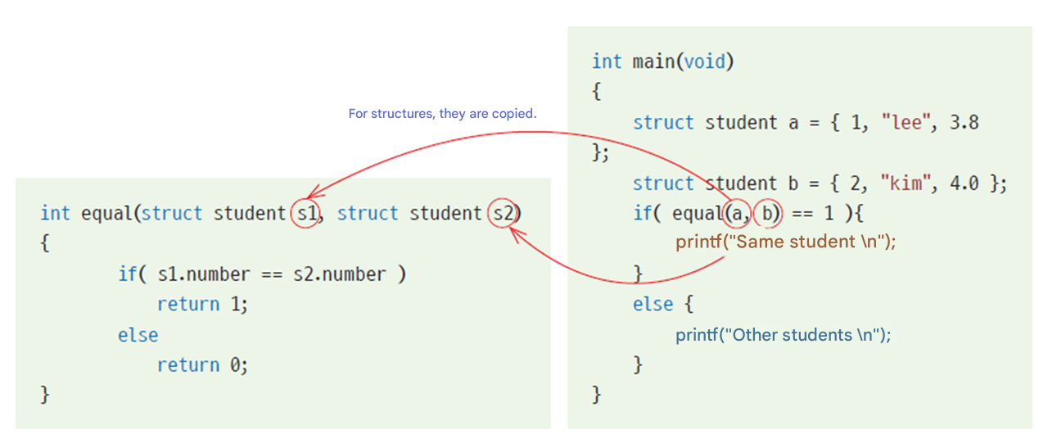
Structures and functions
When passing a structure as an argument to a function
A copy of the structure is passed to the function .
If the size of the structure is large, it takes more time and memory .

Slide 44
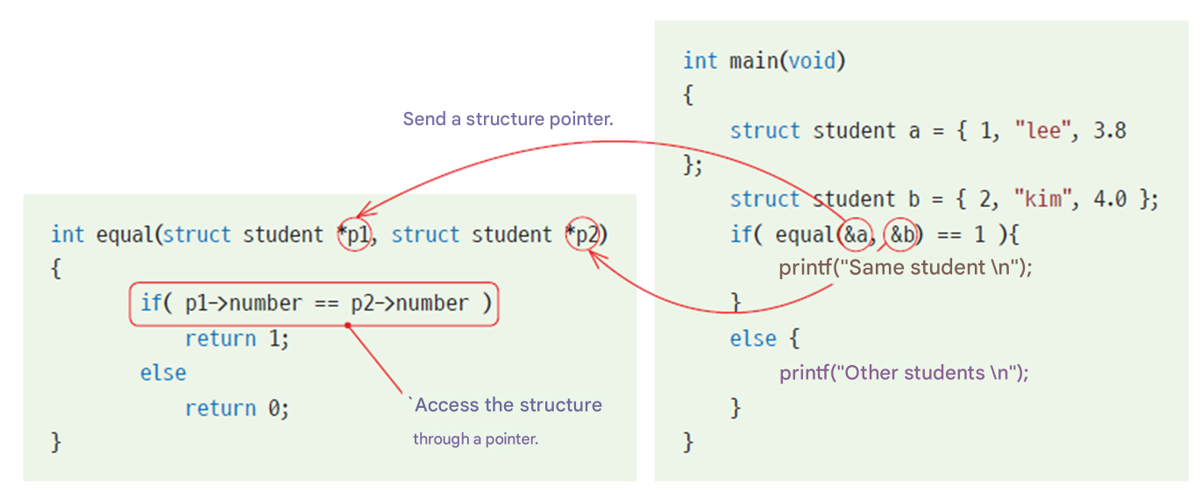
Structures and functions
When passing a pointer to a structure as an argument to a function
It can save time and space .
There is a possibility that the original may be modified .

Slide 45
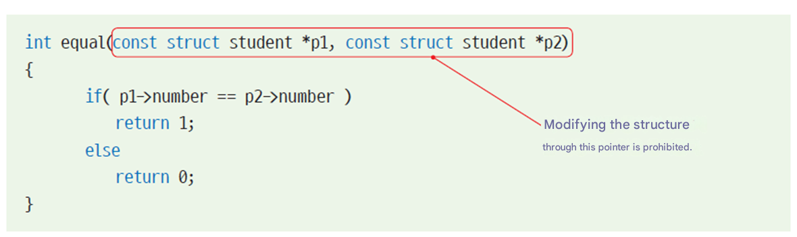
No changes via pointers
If you only need to read the original and do not need to modify it, you can use the const keyword when defining the parameter as follows:

Slide 46
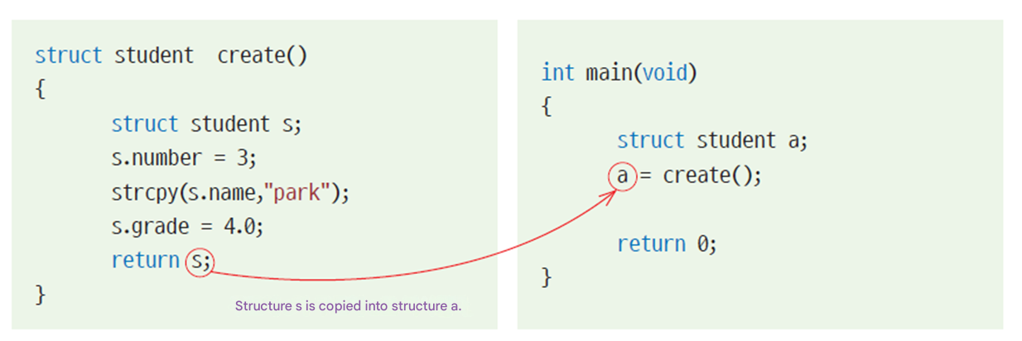
If returning a structure
A copy is returned .

Slide 47
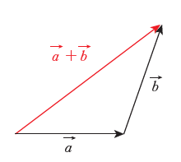
Lab: Vector Operations
Let's create a function get_vector_sum () that calculates the sum of two vectors. This function takes two vectors as arguments, adds them, and returns the vector created as the result of the addition .
The sum of the vectors is (7.000000, 9.000000) .

Slide 48
Example
#include < stdio.h >
struct vector {
double x;
double y;
};
struct vector get_vector_sum ( struct vector a, struct vector b);
int main( void )
{
struct vector a = { 2.0, 3.0 };
struct vector b = { 5.0, 6.0 };
struct vector sum;
sum = get_vector_sum (a, b);
printf ( " vector of The sum is (%f, %f) .\n" , sum.x , sum.y );
return 0;
}

Slide 49
Example
struct vector get_vector_sum( struct vector a, struct vector b)
{
struct vector result;
result.x = ax + bx;
result.y = ay + by;
return result;
}
The sum of the vectors is (7.000000, 9.000000) .

Slide 50
Check points
When passing a struct as an argument to a function, is the original passed or a copy passed?
When passing a pointer to a structure to a function , how can I avoid modiying the structure ?

Slide 51
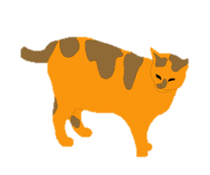


Union
union​
Multiple variables share the same memory area
The way to declare and use a union is very similar to a structure.
union example {
char c; // sharing the same space
int i; // sharing the same space
};

Slide 52
Example
#include < stdio.h >
union example {
int i ;
char c;
};
int main( void )
{
union example v;
v.c = 'A' ;
printf ( " v.c :%c v.i :% i \n" , v.c , v.i );
vi = 10000;
printf ( " v.c :%c v.i :% i \n" , v.c , v.i );
}
Declaration of a union
Declaring a union variable .
Reference to char type .
Reference to type int .
vc:A vi :-858993599
vc :† vi:10000

Slide 53
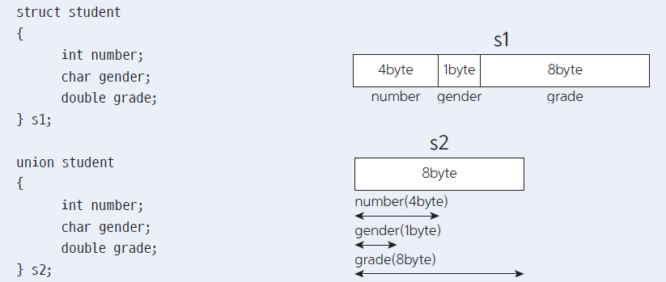
Difference between structure and union

Slide 54
Using type fields in unions
#include < stdio.h >
#include < string.h >
#define STU_NUMBER 1
#define REG_NUMBER 2
struct student {
int type;
union {
int stu_number ; // Student number
char reg_number [15]; // resident registration number
} id;
char name[20];
};

Slide 55
Using type fields in unions
void print( struct student s)
{
switch ( s.type )
{
case STU_NUMBER:
printf ( " Student number %d\n" , s.id.stu_number );
printf ( " Name : %s\n" , s.name);
break;
case REG_NUMBER:
printf ( " Resident registration number : %s\n" , s.id.reg_number );
printf ( " Name : %s\n" , s.name);
break;
default :
printf ( " TypeError \n" );
break;
}
}

Slide 56
Using type fields in unions
int main( void )
{
struct student s1, s2;
s1.type = STU_NUMBER;
s1.id.stu_number = 20190001;
strcpy (s1.name, " Hong Gil-dong " );
s2.type = REG_NUMBER;
strcpy (s2.id.reg_number, "860101-1056076" );
strcpy (s2.name, " Kim Cheol-su " );
print(s1);
print(s2);
}
Student number : 20190001
Name : Hong Gil-dong
Resident registration number : 860101-1056076
Name : Kim Cheol-su

Slide 57
Check points
The keyword used to declare a union is _______ .
How is the size of memory allocated to a union determined ?

Slide 58
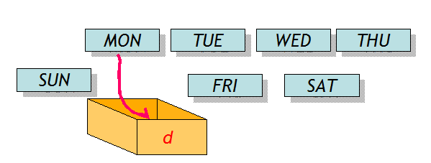
Enumeration
An enumeration is a data type that lists in advance the values that a variable can have.
( Example ) A variable storing the day of the week can only have one of the following values : { Sunday, Monday, Tuesday, Wednesday, Thursday, Friday, Saturday}

Slide 59
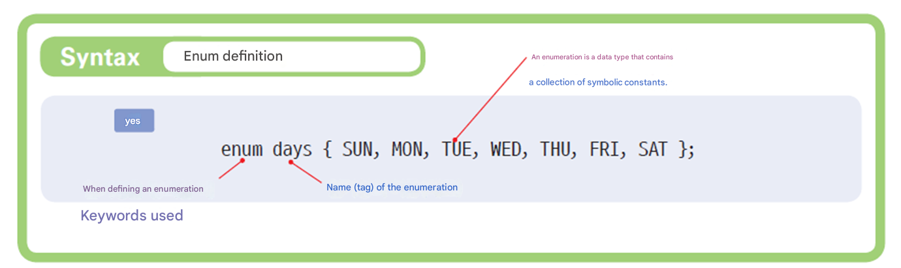
Declaration of enumeration
Declaring enumeration variables
enum days today;
today = SUN; // OK!

Slide 60
Why we need enumerations
You can write a program like this : Let's think about the problem .
int today;
today = 0; // Sunday
today = 1; // Monday
If you use enumerations,
It can reduce errors and improve readability .
The symbolic constant SUN is more preferable than 0, because its meaning is easier to understand .
It is also necessary to block meaningless values ​​such as 9 from being assigned to today in advance.

Slide 61
Enumeration Initialization
enum days { SUN, MON, TUE, WED, THU, FRI, SAT }; // SUN=0, MON=1, ...
enum days { SUN=1, MON, TUE, WED, THU, FRI, SAT }; // SUN=1, MON=2, ...
enum days { SUN=7, MON=1, TUE, WED, THU, FRI, SAT=6 }; // SUN=7, MON=1, ...
If you do not specify a value, it is assigned from 0.

Slide 62
Examples of enumerations
enum colors { white, red, blue, green, black };
enum boolean { false, true };
enum levels { low, medium, high };
enum car_types { sedan, suv , sports_car , van, pickup, convertible };

Slide 63
Example
#include < stdio.h >
enum days { SUN, MON, TUE, WED, THU, FRI, SAT };
char * days_name [] = {
"sunday", "monday", "tuesday", "wednesday", "thursday", "friday", "saturday" };
int main( void )
{
enum days d;
d = WED;
printf ( "The % dth day of the week is %s \n" , d, days_name [d]);
return 0;
}
The third day of the week is wednesday

Slide 64
Comparison of enumerations with other methods
Use of integers | Symbolic Constant | Enumeration
switch (code) { case 1: printf ( "LCD TV\n" ); break ; case 2: printf ( “OLED TV\n" ); break ; } | # define LCD 1 #define OLED 2 switch (code) { case LCD: printf ( "LCD TV\n" ); break ; case OLED: printf ( “OLED TV\n" ); break ; } | enum tvtype { LCD, OLED }; enum tvtype code; switch (code) { case LCD: printf ( "LCD TV\n" ); break ; case PDP: printf ( “OLED TV\n" ); break ; }
Computers are easy to understand, but people have difficulty remembering . | Errors can be made when writing symbolic constants . | The compiler checks to ensure that no duplication occurs .

Slide 65
Check points
1. The keyword used to declare an enumeration is _______ .
2. In what cases are enumerations used ?
3. If a value is not specifically specified in an enumeration, is an integer value automatically assigned ?

Slide 66
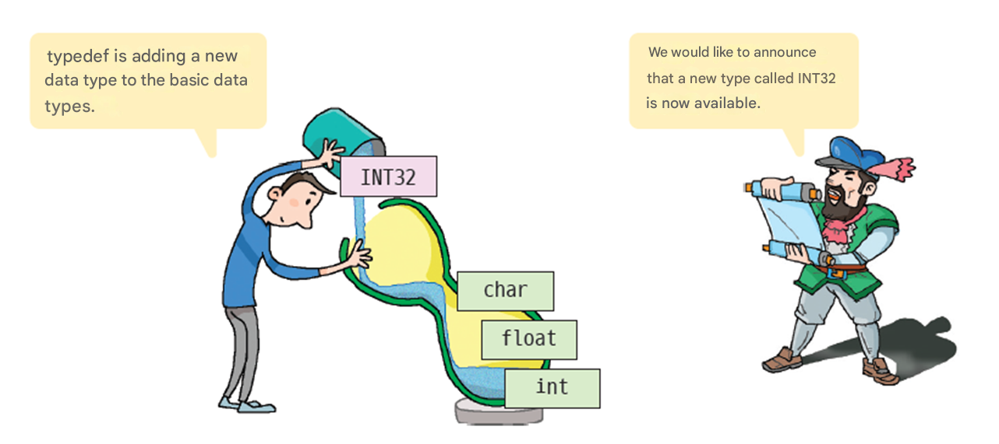
The concept of typedef

Slide 67
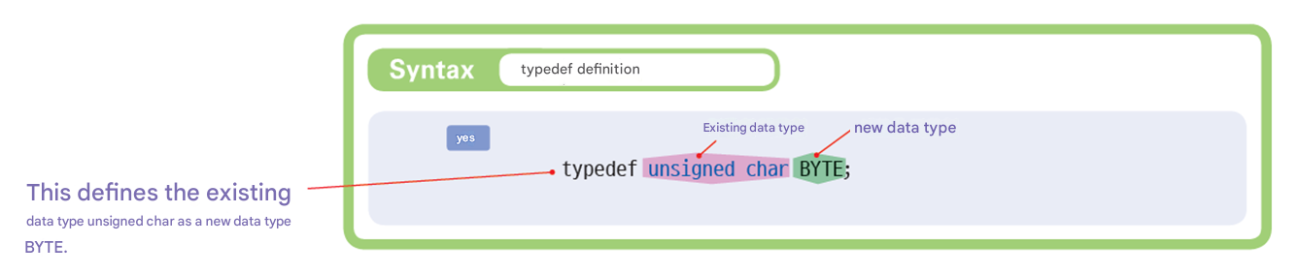
typedef

Slide 68
Example of typedef
typedef unsigned char BYTE;
BYTE index; // Same as unsigned int index;
typedef int INT32;
typedef unsigned int UINT32;
INT32 i; // Same as int
UINT32 k; // Same as unsigned int k ;

Slide 69
Defining a new type as a struct
As a structure You can define new types .
struct point {
int x;
int y;
};
typedef struct point POINT ;
POINT a, b;
typedef struct complex {
double real;
double image;
} COMPLEX;
COMPLEX x, y;

Slide 70
Comparison of typedef and #define
Increases portability .
Code can be made independent of computer hardware
( Example ) The int type is 2 bytes or 4 bytes . If you use INT32 or INT16 using typedef instead of the int type, you can clearly specify whether it is 2 bytes or 4 bytes .
You can achieve a similar effect to typedef by using #define . That is, you can define INT32 as follows :
#define UINT32 unsigned int
typedef float VECTOR[2];// Not possible with #define .
It also serves as documentation .
Using typedef has the same effect as adding a comment.

Slide 71
Check points
1. What is the use of typedef ?
2. What are the advantages of typedef ?
3. Let 's define a structure representing an employee and define it as a new type called employee using typedef .

Slide 72
Q & A

